Slide 1
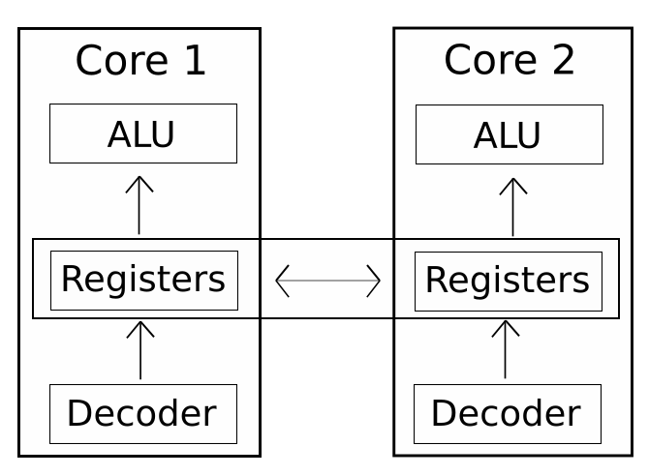
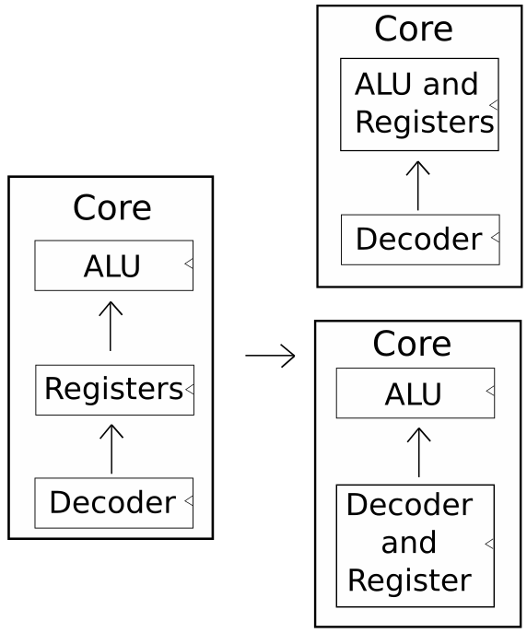
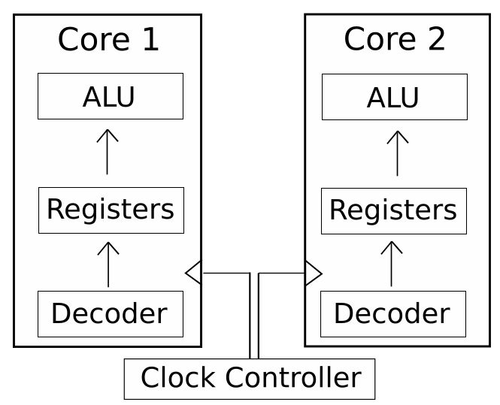
Dark Silicon and Task Scheduling for RISC-V
Thomas Steel - Supervised by Matt D’Souza
OVERVIEW
RISC-V
RISC-V is an open source ISA that is modular. It has a base instruction set to handle integer addition,subtraction and bitwise operations as well as standard branching, loading and storing operations. Other instruction sets handle multiplications, floating points, control status registers and more.
Dark Silicon
As transistor size goes below 32nm, the previously linear relationships between die size and power density becomes an exponential relationship. This power density results in heat generation which exceeds our capacity to cool chips.
Methodology
The focus of this thesis is on methods which use dynamic frequency scaling or reduced frequency implementations, as well as implementations that use multicore design to manage heat spots on the chip.
Results
Due to the COVID-19 outbreak, the complexity of implementing an OS onto a RISC-V CPU for testing, and the sparsity and unreliability of materials on the subject, the costs and benefits of the devised methods were unable to be determined.
CORE SWITCHING
Saving and loading variables to and from the stack while task scheduling reduces data throughput at the cost of additional instructions which generates heat in the system.
By scheduling a task for every core in a multi-core chip, a form of computational sprinting can be implemented where each core is sprinted and then run at a reduced frequency or paused until cooled down. Distributed memory can be held between the cores for shared memory purposes, with appropriate controls for race conditions.
To allow an alternative for single threaded programs the registers should be connect the registers of cores. This allows each core to be sprinted and then paused, with the program being jumped over to another core to continue processing.
REDUCED FREQUENCY CORES
A key element of a reduced operating frequency is that this increases the maximum length that the critical path can be in a CPU. Taking this to an extreme, you can reduce the number of sequential stages into a cpu, thereby reducing the number of CPU cycles required to complete an operation. This design would capitalise on the metaphorical “free real estate” that is the otherwise unused dark silicon to produce a circuit that inefficient for space but efficient for clock cycles.

